Slide 1

IMDB MOVIE ANALYSIS

Slide 2
ABOUT ME :
1)SRI HARSHITHA GADDAMANUGU :
A computer science graduate from Swarna Bharathi institute of science and technology .
Excelling my career in data analytics with innomatics research labs as a platform
Linkedin : www.linkedin.com/in/sri-harshitha-gaddamanugu
Github :https://github.com/Sriharshitha123
2)SUSHMA REBBA:
A computer science graduate from Priyadarshini institute of science and technology .
Excelling my career in data analytics with innomatics research labs as a platform
Linkedin : https://www.linkedin.com/in/sushma-rebba-a76b4a265/
3)AKASH THYADI :
4 Years experience in Sutherland and wipro as quality analyst .
Excelling my career in data analytics with innomatics research labs as a platform
Linkedin : https://www.linkedin.com/in/thyadi-akash-15478b228/

Slide 3
PROBLEM STATEMENT : IMDB MOVIE ANALYSIS OF TOP 500 MOVIES BASED ON MOVIE NAME, VOTES,METASCORE, RATING AND YEAR RELEASED WITH DATA IN WEBSITE
OBJECTIVE :
1)Analyzing Movie Trends and success factors
2)Predicting Movie ratings
3)Visualizing Movie Data For Actionable insights

Slide 4
INTRODUCTION:
This project is an exploratory data analysis on movie ratings where its starts from web scraping ,Data Collection, Data Cleaning, Data Analysis, Visualization and Conclusion.
Data analysis Process:
It's a five-step framework to analyze data.
1) Identify business questions,
2) Collect and store data,
3) Clean and prepare data,
4) Analyze data,
5) Visualize data.

Slide 5
MODULES USED : NumPy (np): NumPy is a fundamental library for numerical and mathematical operations. It provides support for working with arrays and matrices. Pandas (pd): Pandas is a powerful library for data manipulation and analysis. It introduces data structures like DataFrames for easy handling of tabular data. Matplotlib (plt): Matplotlib is a popular library for creating static, animated, or interactive visualizations in Python. It's commonly used for plotting charts and graphs. Seaborn (sns): Seaborn is a data visualization library that works in conjunction with Matplotlib. It provides a high-level interface for creating informative and attractive statistical graphics. Requests: The 'requests' library enables making HTTP requests to fetch data from websites. It's essential for web scraping. Beautiful Soup (from bs4 import BeautifulSoup): Beautiful Soup is a library for web scraping. It allows you to parse and navigate HTML and XML documents, making it easier to extract data from web pages.

Slide 6
WEB SCRAPING :
Web scraping is a term used to describe the use of a program or algorithm to extract and process large amounts of data from the web.
Web Scraping process:
Find the URL that we want to scrape.
Write the code to extract the data by importing requests and BeautifulSoup.
Store the extracted data and convert it into dataframe.
Then convert it to a csv file.
The website we used for extraction is:
https://www.imdb.com/list/ls050782187/?sort=list_order,asc&st_dt=&mode=detail&page={page_number}

Slide 7
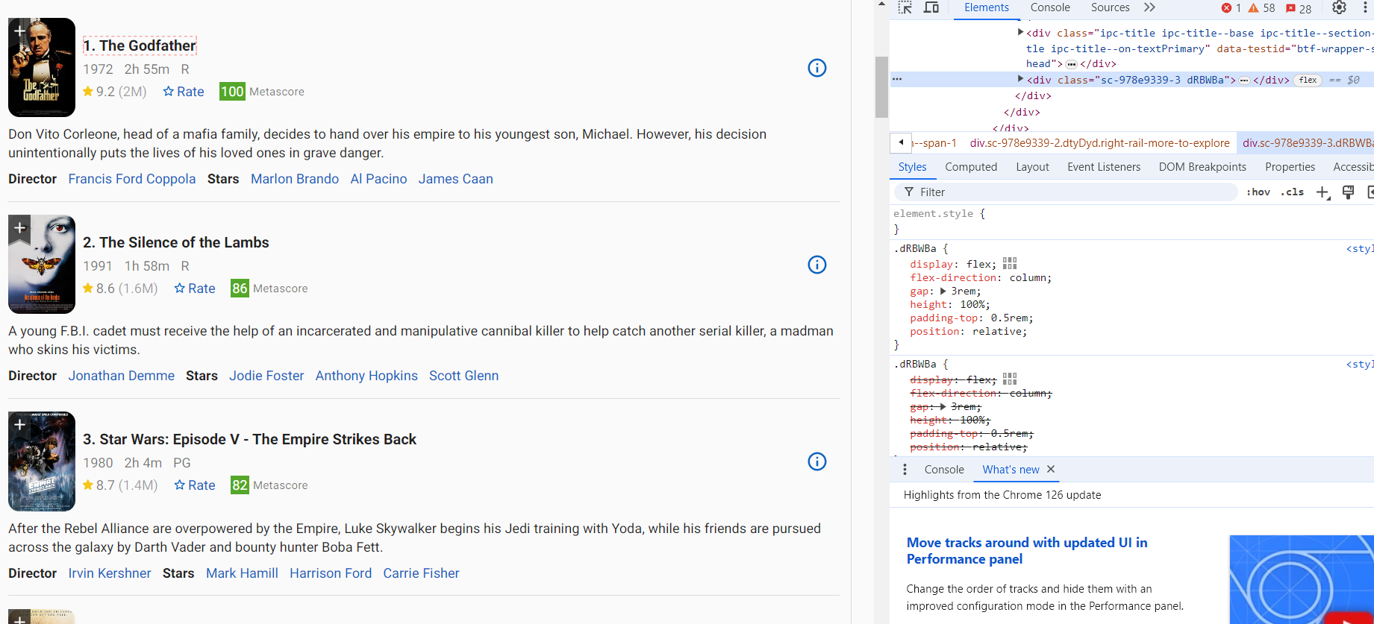
Web Interface HTML

Slide 8
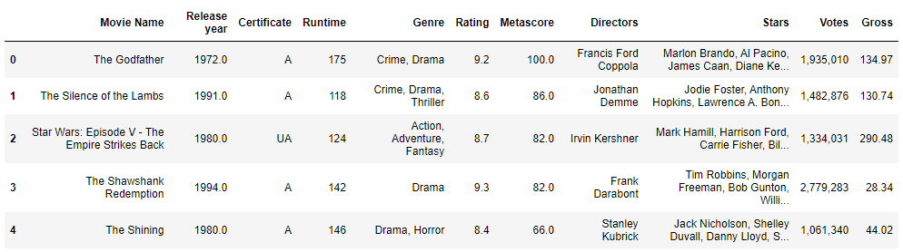
DATA COLLECTION:
500 rows × 12 columns

Slide 9
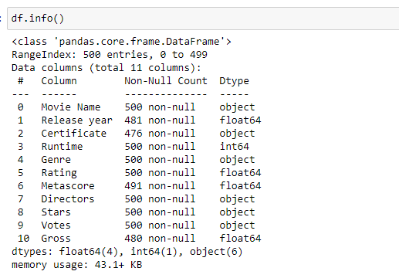
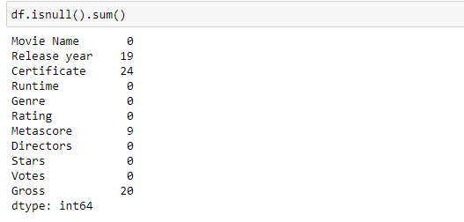
Before Data Cleaning
There are 19 null values in Release Year column,24 null values in certificate column,9 null values in metascore column and 20 null values in gross column

Slide 10
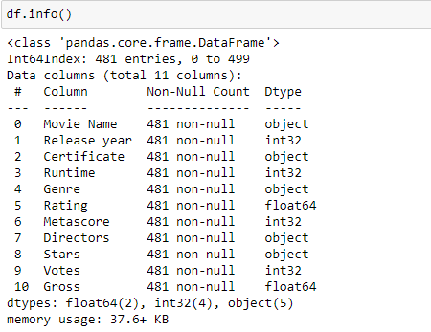
Data Cleaning :
After filling and dropping of null values there are 481 data points,11 columns and 0 null values.
Also Dtype is converted to the respected column.

Slide 11
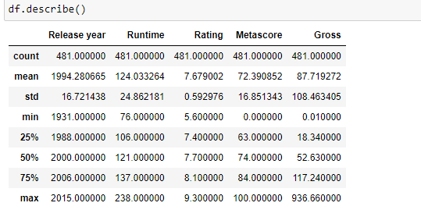
DATA ANALYSIS
Describe Generate descriptive statistics.
Minimum runtime is 76 min.
Maximum runtime is 238 min.
Minimum rating is 7.6.
Maximum rating is 9.3.

Slide 12
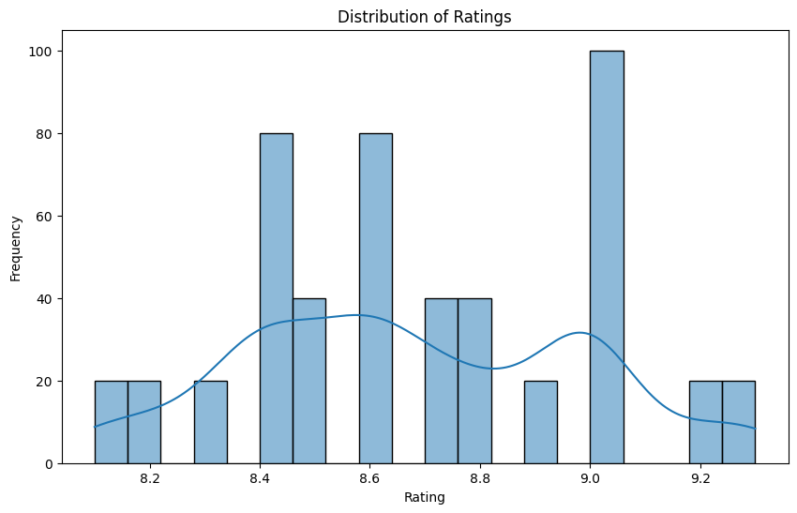
Data Analysis With Visualization : (UNIVARIATE ANALYSIS)
1) For rating 9.0 the frequency is high
2) For rating 8.2,9.2 has same frequency
Distribution of Movie Ratings (Histogram) This histogram shows how movie ratings are distributed across the dataset.

Slide 13
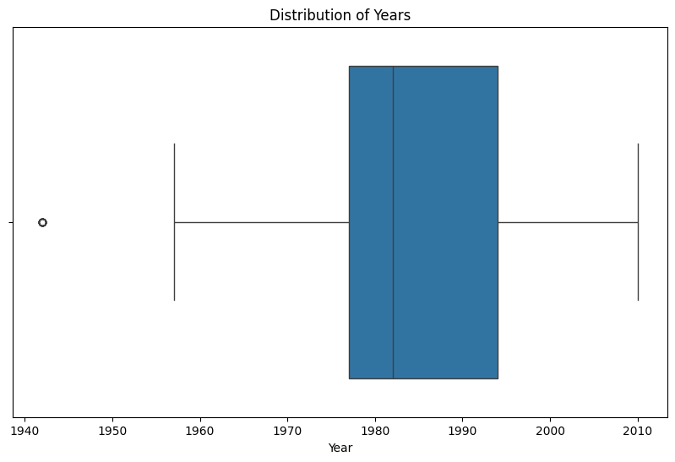
Distribution of Movie Release Years (Box Plot) This box plot provides a visual summary of the distribution of movie release years, showing the median, quartiles, and potential outliers.
Maximum movies are released between 1980 and 1990

Slide 14
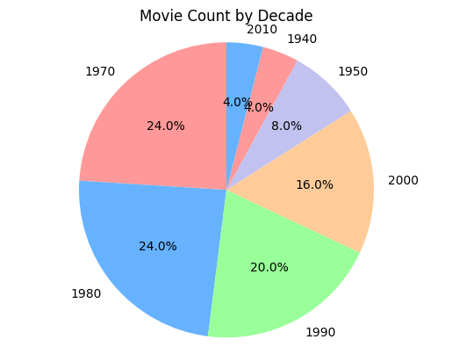
Pie chart of movie counts by decade : A pie chart showing distribution of movie counts by decade,using 5 colors
Maximum area covered by movie count is in 1980 and 1990
In 2000 the movie count is 16.0%
In 2010 and 1940 the movie count is least

Slide 15
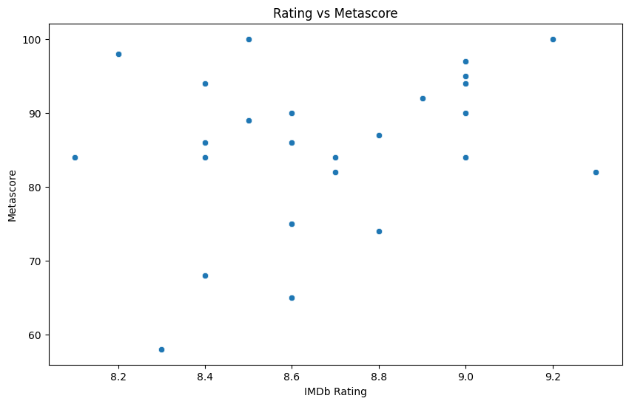
BIVARIATE ANALYSIS :
Rating vs Metascore (Scatter Plot) This scatter plot explores the relationship between IMDb ratings and Metascores, revealing any potential correlations or trends.
Mostly Imdb rating has metascore between 90 and 100
Mostly imdb rating are scattered between 8.4 and 9.0

Slide 16
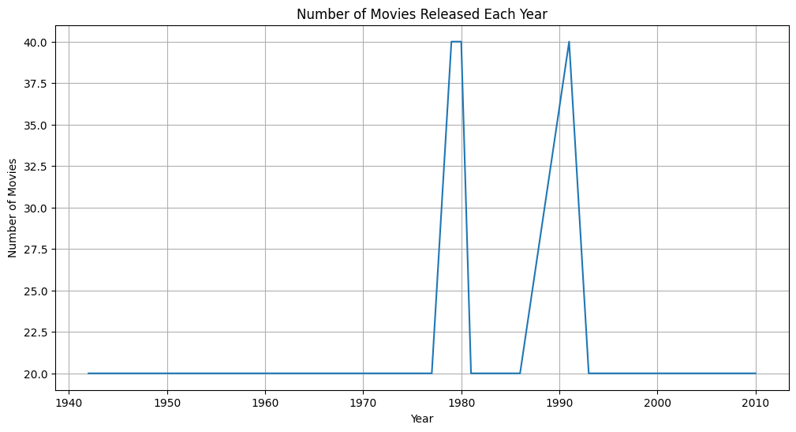
Number of Movies Released Each Year (Line Chart) This line chart shows the trend of movie releases over the years, highlighting any significant increases or decreases in production.
Major number of movies are released in 1980 and 1990 with 40.0 score of number of movies

Slide 17
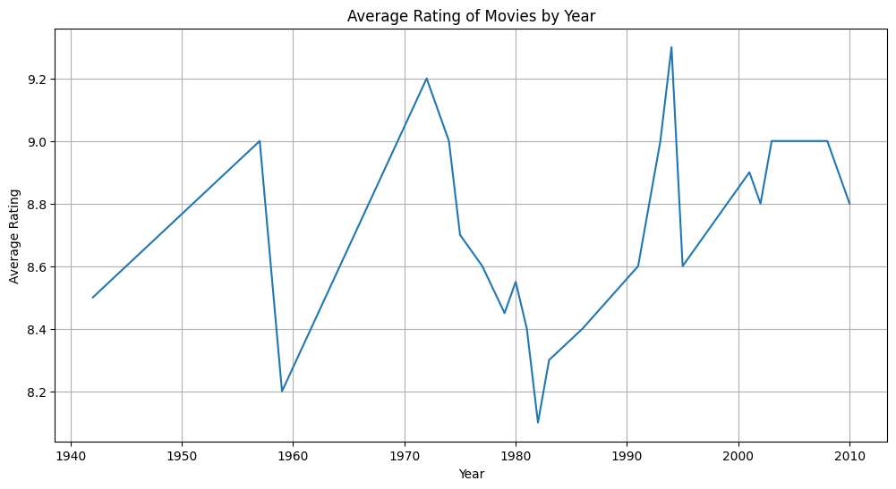
Average Rating by Year (Line Chart) This line chart displays how the average rating of movies has changed over the years, providing insights into potential trends in movie quality.

Slide 18
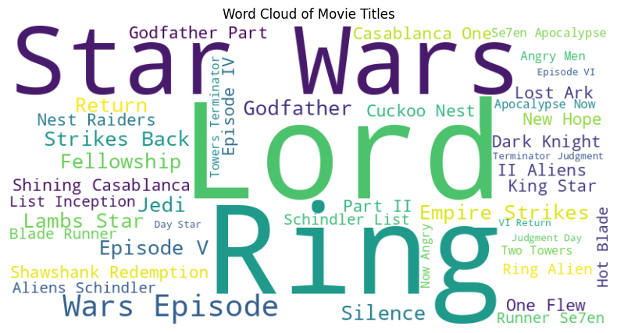
MULTIVARIATE ANALYSIS :
Word Cloud of Movie Titles This word cloud visually represents the most frequent words in the movie titles, giving an overview of common themes or genres.

Slide 19
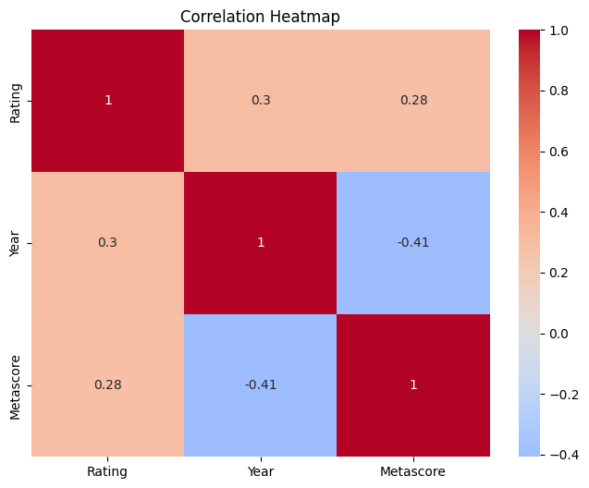
Correlation Heatmap This heatmap visualizes the correlation between different numerical variables in the dataset, such as rating, year, and Metascore, helping to identify potential relationships
By observing the heatmap, you can quickly identify potential relationships. Darker colors (positive or negative) suggest stronger correlations, while lighter colors indicate weaker correlations.

Slide 20
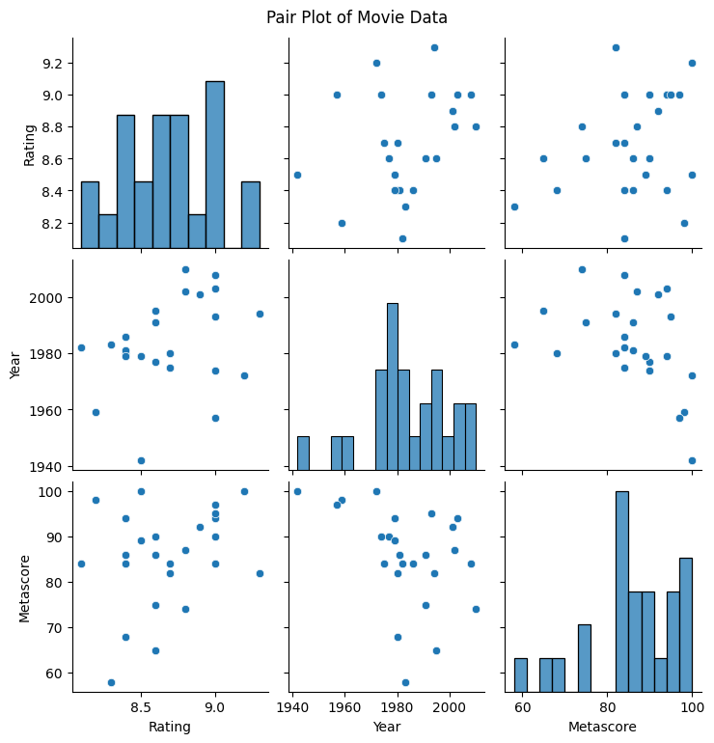
Pair Plot This pair plot creates scatter plots for all pairs of numerical variables, along with histograms for individual variables, providing a comprehensive overview of the relationships within the data.

Slide 21
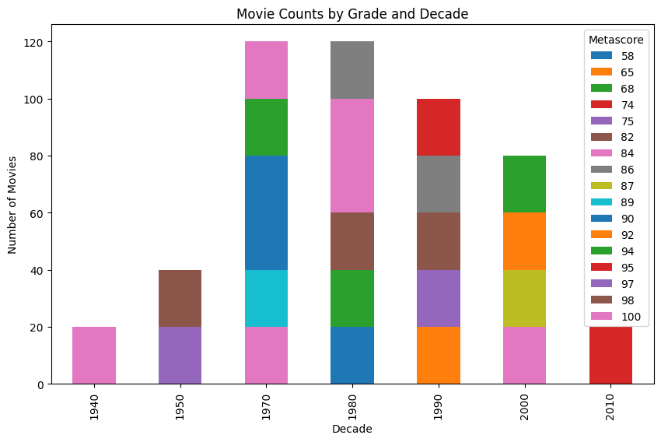
Stacked Bar Chart of Movie Counts by Grade and Decade This stacked bar chart shows the number of movies for each grade within each decade, providing a breakdown of movie content over time.

Slide 22
CONCLUSION :
At last we conclude that:
Steven Spielberg is top director based on movie rating.
The Shawshank Redemption is the top movie based on rating. But Star Wars: Episode VII - The Force Awakens movie has the highest gross.
Top most genre based on ratings and metascore is Drama . But “Action, Adventure, Sci-Fi “ is the genre which has high votes.

Slide 23

THANK YOU

